Slide 1
The USA National Phenology Network Land Surface Phenology/Remote Sensing Phenology Program
Jesslyn Brown USGS Earth Resources Observation Systems Kamel Didan, University of Arizona
Bill Hargrove, US Forest Service
Jeff Morisette, US Geological Survey
Joanne Nightingale, Jaime Nickeson, Robert Wolfe: NASA GSFC
Crystal Schaaf, Mark Friedl, Boston University Xiaoyang Zhang, NOAA
Notes:
Thank you, for that introduction.

Slide 2
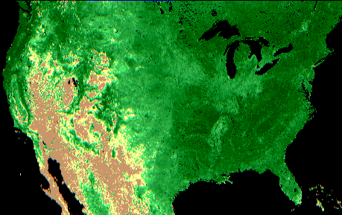
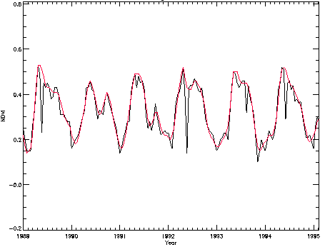
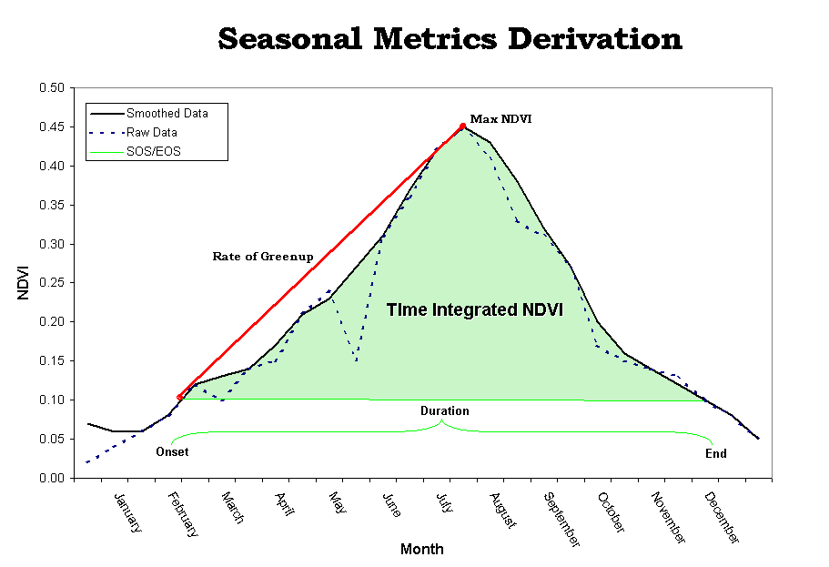
Land Surface Phenology
Time-series satellite data allow extraction of phenological events on a landscape level
Start of Season
End of Season
Length of Season
Peak of Season
Notes:
The value of the satellite database that has been consistently processed and is provided by the USGS EROS Data Center as a standard product is what we want to show here. We also calculate a number of other measures from the NDVI (Normalized Difference Vegetation Index—aka “Greenness”). Including Percent of Average Seasonal Greenness (next slide) that is a relative indicator of actual vegetation performance related to the mean performance for each 1–km pixel.

Slide 3
Global LSP Products
Product | Satellite/VI Source | Production | Spatial | Contact/Agency
MODIS Land cover dynamics MOD12Q2 | MODIS (EVI) | 2001 - | 500m | Mark Friedl (BU / NASA)
GEOLAND 2 BIOPAR Phenology | SPOT-Vegetation (NDVI) | 1980-2009 | 1km | Roselyne Lacaze (JRC, VITO, MEDIAS)
MTCI | MERIS (Terrestrial Chlorophyll Index) | 2003-2007 | 4.6km | J Dash (ESA)
Sensor Independent Vegetation Phenology (SIVP) | Fusion: AVHRR, SPOT-VGT, MODIS, VIIRS (NDVI) | 1981-2013 | 0.05 deg | Kamel Didan (U Arizona / NASA)

Slide 4
North American Continent LSP Products
Product | Satellite/VI Source | Production | Spatial | Contact/Agency
USFS National Phenology Database | MODIS (NDVI) | 2003-2008 | 231m | Bill Hargrove (USFS / NASA)
NASA NACP Phenology Product | MODIS (NDVI, EVI, LAI, NBAR EVI/NDVI) | 2000-2008 | 250m, 500m, 1km | Jeff Morisette (NASA)
USGS Phenology | AVHRR (NDVI) | 1989-2008 | 1km | Jesslyn Brown (USGS)
NOAA GVIx Phenology | AVHRR (GVIx) | 1981-2008 | 4km | Xiaoyang Zhang (NOAA)

Slide 5
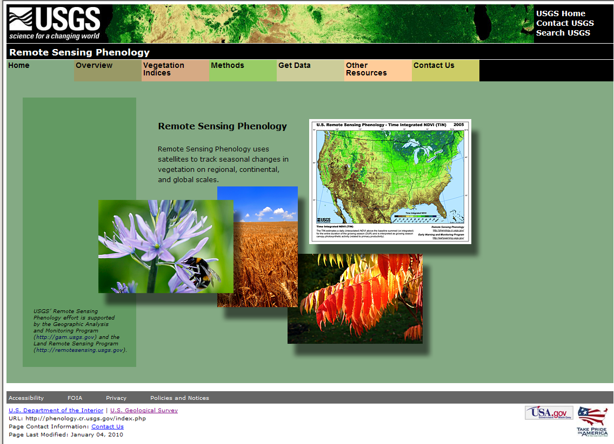
http://phenology.cr.usgs.gov/index.php

Slide 6
Other LSP Products / Datasets
Product | Satellite | Production | Spatial | Contact/Agency
CSIR Phenology South Africa | AVHRR (NDVI) | 1985-2000 | 1km | Konrad Wessels (CSIR)
JRC MERIS Phenology | MERIS (fPAR) | TDB 2010
Direct Broadcast NBAR – NDVI / EVI | MODIS | 2000 - | 500m | Crystal Schaaf (BU / NASA)

Slide 7
Need for validation/assessment of phenology products
Confusion among users about multiple products
Need to improve confidence and scientific credibility
To date, validation and assessment has been minimal and more or less ad hoc (e.g., assessments performed using only a handful of scattered ground sites)

Slide 8
Phenology SOS Validation
White et al., 2009, Global Change Biology
Assessed 10 methods for SOS determination.
Used common source data.

Slide 9
LSP Products: Comparing Characteristics*
Product | MODIS Land Cover Dynamics
 | comments on source, preprocessing, phenology algorithm
Sensor Independent Vegetation Phenology (SIVP) | MLCD base algorithm providing basis for SIVP processing
USFS National Phenology Database | Same input (MODIS), similar algorithm, differs primariliy in pre-processing
NASA NACP Phenology Product | same source, different preprocessing, slightly different algorithm, proposal currently in-review that could lead to convergence of algorithm
USGS Phenology | Different source, prepocessing and algorithm
NOAA GVIx Phenology | Different source, same basic algorithm differs mostly in terms of preprocessing
Direct Broadcast NBAR – NDVI / EVI | Same sensor, different preprocessing.
* So far, for U.S. products only

Slide 10
LSP Products: Comparing Characteristics
Product | NASA NACP Phenology Product
 | comments on source, preprocessing, phenology algorithm
MODIS Land Cover Dynamics | Same source, different preprocessing, slightly different algorithm, proposal currently in-review that could lead to convergence of algorithm
Sensor Independent Vegetation Phenology (SIVP) | Coordination with "MODIS Land Cover Dynamics" could enable some convergence with SIVP
USFS National Phenology Database | Same source, different preprocessing and algorithm
USGS Phenology | Different source, preprocessing, and algorithm
NOAA GVIx Phenology | Different source, preprocessing, and algorithm
Direct Broadcast NBAR – NDVI / EVI | Different source, preprocessing, and algorithm

Slide 11
LSP Products: Comparing Characteristics
Product | USGS Phenology
 | comments on source, preprocessing, phenology algorithm
MODIS Land Cover Dynamics | Different source, preprocessing, and algorithm
Sensor Independent Vegetation Phenology (SIVP) | Different source, preprocessing, and algorithm
USFS National Phenology Database | Different source, preprocessing, and algorithm
NASA NACP Phenology Product | Different source, preprocessing, and algorithm
NOAA GVIx Phenology | Same sensor (different resampling, different resolution), different preprocessing, and algorithm
Direct Broadcast NBAR – NDVI / EVI | Different source, preprocessing, and algorithm

Slide 12
LSP Products: Comparing Characteristics
Product | NOAA GVIx Phenology
 | comments on source, preprocessing, phenology algorithm
MODIS Land Cover Dynamics | Different source, slightly different preprocessing, similar algorithm
Sensor Independent Vegetation Phenology (SIVP) | Some convergence with SIVP
USFS National Phenology Database | Different source, preprocessing, and algorithm
NASA NACP Phenology Product | Different source, preprocessing, and algorithm
USGS Phenology | Same sensor, different resolution, preprocessing, and algorithm
Direct Broadcast NBAR – NDVI / EVI | Different source, preprocessing, and algorithm

Slide 13
LSP Products: Comparing Characteristics
Product | Direct Broadcast NBAR – NDVI / EVI
 | comments on source, preprocessing, phenology algorithm
MODIS Land Cover Dynamics | Same sensor (MODIS swath data from DB), similar preprocessing but NBAR retrieved daily rather than 8 days -- 500m -- similar algorithm
Sensor Independent Vegetation Phenology (SIVP) | Different source, different resolution, different preprocessing
USFS National Phenology Database | Uses the operation NBAR (as does MODIS land cover dynamics), different algorithm
NASA NACP Phenology Product | MODIS, similar algorithm for NBAR but generating 500m gap filled for creation of NBAR-EVI or NBAR-NDVI -- this is created under the same processing as the other NACP products and the NACP algorithm will be applied to the gap filled sequence (or the DB xyz version could as well).
USGS Phenology | Different source, different algorithm
NOAA GVIx Phenology | Different source, different prerpocessing, similar algorithm

Slide 14
Some general questions to consider
Base data : why not higher frequency than the current composited multi-day products
Link to what is on the ground
How could we all move to a "best practice" - "best approach" RS methodology * Based on what?
How do these RS-LSP products help with carbon cycle/budget
How to help the community decipher the differences
Set of guidelines to help promote the different products
Wish list to promote better RS LSP (resolution, frequency, spectral, etc...)
Inform where and how to use these products
Notes:
These were from Kamel’s e-mail.
1 Okay again Kamel has raised these issues of frequency versus multi-day (frequency versus quality really).
2 How do we link this to the ground --- well obviously daily airborne flights to obtain vis/nir imagery of a fairly large uniform patch of vegetation would be awesome and would provide the direct link between satellite and near surface pixels…. But that is unlikely cost wise …..webcams pointed more downward from tall towers like Cheas are another possibility to capture more heterogeneous landscapes…. Webcams are wonderful although the fact they look out horizontally while satellites look downward from the top make them harder to link up….
3. Best practice best approach --- hmmmm well it seems to me that all we can do is identify a few terms that we think we can see from space and then try to come up with some overall thresholds for these terms that aren’t algorithm or sensor specific.. something like our pixels is demonstrating a 10% (or some specified percentage) change (whether it be ndvi, evi, greeness) to indicate pixel wide first greenup….or maybe a sustained increase of so much over multiple periods…. This is frankly the item that we are all stuck on and it would be great if the workshop helped us with this..
4. Well obviously identifying the growing season (the active season) is key – as is the contribution knowing the growing season is to better identifying the surface cover characterisitcs (PFTs or whatever)….
5/6 Well the problem here is that all of these products give you slightly different values for the general terms of “greenup” --- perhaps if we hammer down the definitions better then they all will give us similar answers for the general terms and then the only differences are the “other parameters” that each data sets is focused on providing for their specific user……..
7. Well personally I want a daily 30meter resolution Polder (fully multiangle) with at least all the MODIS channels out into the SWIR and sufficient thermal as well to decently define cloud clear!!! Grins
8. Well this is the same as 5/6

Slide 15
Product Intercomparison
Similarities in products could increase confidence (i.e., “convergence of evidence”)
Risk—divergence in products contributes to further confusion
Product differences (e.g., source, preprocessing, and algorithm) makes results difficult to interpret!
Need for complete transparency--make ALL data sets (both ground and satellite phenology) easily available and accessible to all participants.

Slide 16
Potential Assessments—Application Driven
Carbon modeling
Ecosystem
Land management
Sensitivity to climate change
Notes:
Hmmmm not sure what you were thinking of for this – is this looking at the different needs of these three application communities???
In which case you could look at the other parameters that each of these communities needs --- other then our more general terms of beginning of greenup and beginning of senescence or whatever we’ve come up with in item 3 on slide 9 – what are the general terms that all the phenologies can see and get within some variability (can all the products get “greenup –however we’ve defined that” within a week????)

Slide 17
Phenology validation network
What would this look like?
How could we sustain it?
Possible methods/measures
Webcams
Spectral radiometers (mounted high and pointing down)
Notes:
Well, I’m a webcam fan – just wish they were on higher towers (some problem I have with albedometers) and pointing downward….
Speaking of albedometers, spectral radiometers would help a lot too – I like those a lot – NOAA has one at Table Mtn but so far hasn’t got to fund a more extensive network….. Cheapo Par sensor do less for me although perhaps if they were deployed in a spatially extensive fashion (like in citizen science) they would be very useful
Citizen science is most interesting when for instance, sufficient backyards around one elementary school are linked up to provide us with info on first leaf and flowering and fully leafed out and then color estimates and then complete leaf drop – so we end up with a spatial extent that covers a pixel or two…
But again, what kids on the ground can figure out is different than what we see from space --- still spatial measurements of when all the lawns greened up and when all the maples flowered (I’m thinking New England here of course) and when all the willows leafed out etc etc is really helpful…

Slide 18
What is the ideal measurement (or suite of measurements)
Continuous in time
Scientific units
Others…
…or consider minimum criteria…
Notes:
Jess, Well this comes back to the question of what is the phenology that we can see from space --- it appears to be combined phenological response of all the vegetation in a satellite pixel – understory, overstory, flowering etc… So really what we are seeing is sufficient biomass to emerge and become photosynthetically active for us to see it from space at a stand resolution (with 250 to 500m pixels) for greenup. Then what are we going to declare as senescence or dormancy???
Furthermore from my standpoint I’d say that quality affects us more than continuous because we NEVER can see the surface 100% of the time from optical imagery and therefore we are constantly dealing with issues of cloud contamination – there fore it seems to me that generating a consistent dataset of the highest quality is the most important problem we face and when we know we have the highest quality data set we can get, then we determine the first absolute hint of greenup within a couple of day period (and feel confident that we are getting the start of the growing season pretty accurately…… So although I’m psyched that I can get daily values from my Direct Broadcast algorithm I am most excited about that because it maximizes my opportunites to get a consistent high quality record of the phenology…. It even lets me play games with using varying numbers of retrievals and see how robust my answer is….
Does that make sense???

Slide 19
